Slide 1

Department of Automobile Engineering
Dr. D. Y. Patil Educational Academy's
D. Y. Patil School of Engineering Academy, Ambi
Pune - 410506
[2022 - 2023]
Project Stage Presentation On
Liquid Battery Cooling System
Project Group No. 10
Mr. Anshul Whankede
Mr. Audumbar Awate
Mr. Preston Trinidade
Mr. Anirudh Shelar
GUIDED BY
PROF. Rahul Pharande

Slide 2
Introduction
Electric vehicles (EVs) are preferred Lithium-ion batteries for energy storage on its technical features. The higher cost, low discharge rate, long life cycle, and limited energy density of the currently available li-ion battery results in low efficiency to overcome these issues at their fullest capacity [1]. The performance of EVs is highly reliant on the battery capacity and its core temperature plays a major role in battery performance. Wan et al [2] studied thermal performance of a miniature loop heat pipe using water-copper Nano fluid. Mochizuki et al (2014) studied Heat pipe-based passive emergency core cooling system for safe shutdown of a nuclear power reactor. Zhao et al [3] reviewed the thermal performance improving methods of lithium-ion battery electrode modification and thermal management system. The battery temperature has a strong effect on charging and discharging rate of the battery. This makes the thermal management of an EV battery pack extremely important, design of energy-dense packs have to employ robust cooling systems, often using liquid cooling loops with hundreds of channels. The complexity of these systems adds to the cost – somewhere around 10-20% of the overall cost of the battery pack.

Slide 3
Li-ion batteries are particularly susceptible to thermal run away events for a few different reasons, including their high energy content and their propensity to self-heat once the electrolyte reaches a certain temperature (from 70° to 130° C). Li-Ion cells are naturally subjected to deterioration with time due to their operating conditions and state of charge. Temperature has a major impact on the efficiency of nearly all batteries [4]. Due to popularity of rapid charging and performance driving, the heat losses in the cell increases due to high current in the cells [4]. There are two main sources of heat generation in a battery cell: electrochemical operation and joule heating due to the motion of electrons within a battery cellsThe temperature range of 25 °C to 40 °C provides the ideal working conditions for Li-ion batteries and if the temperature is elevated above 50 °C

Slide 4
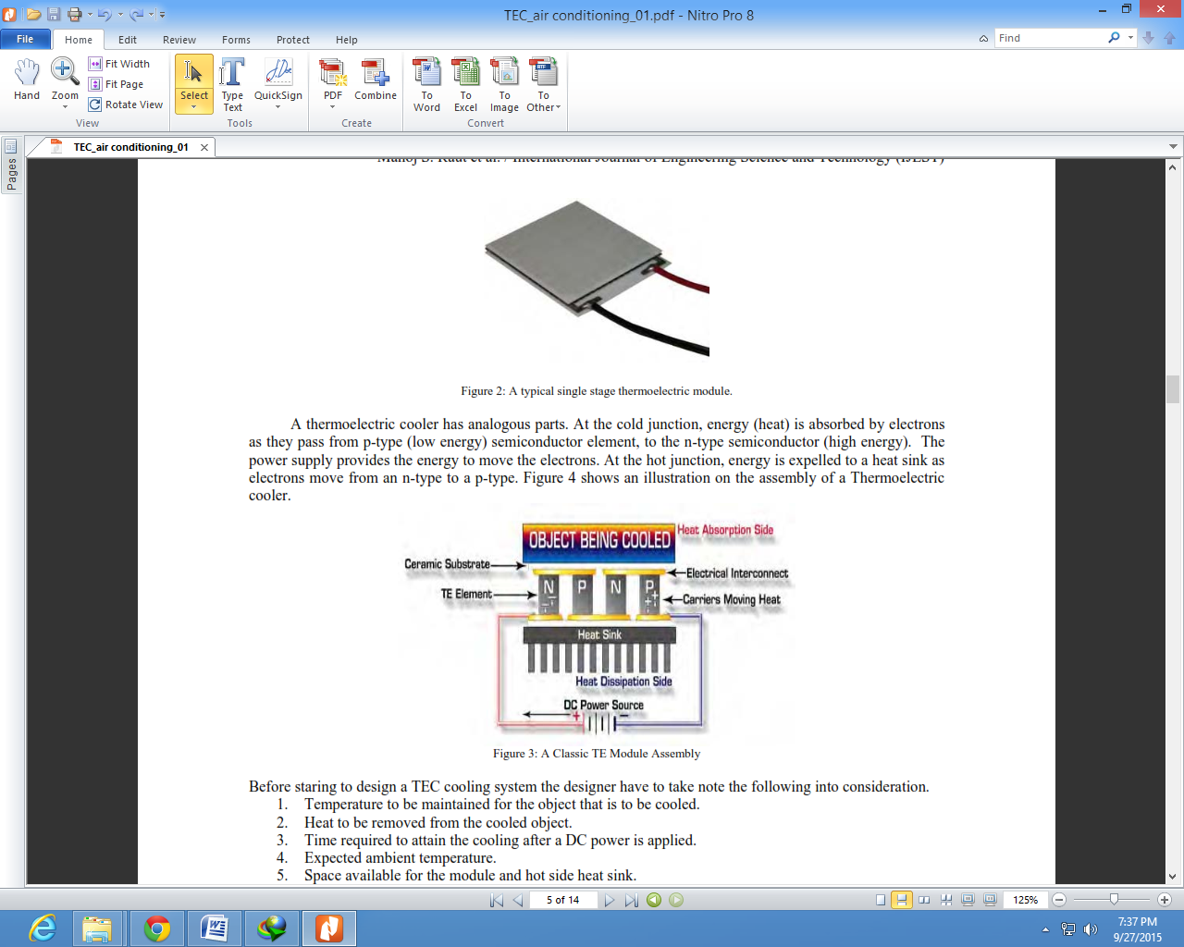
Aim and Objective

Slide 5
Our aim by doing this project is to create a safe and cost effective way to control the problem faced today in EV two wheelers that is its heating issue
Our system goal is to add extra cooling pad, run cooling liquid thru the system and use various materials to transfer the heat generated from the battery and dissipate it quickly

Slide 6
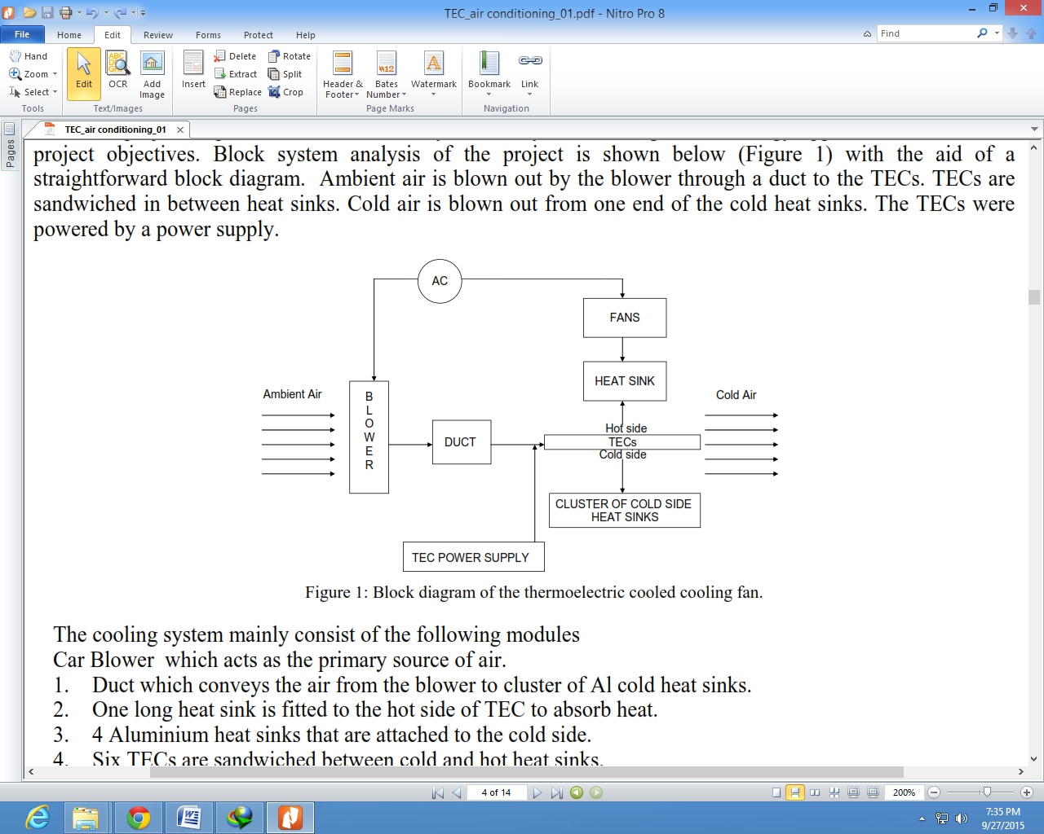
Block Diagram of Cooling Fan

Slide 7
Methodology for Proposed work
The project implemented a structured system analysis and design methodology approach to achieve the project objectives. Block system analysis of the project is shown below (Figure 1) with the aid of a straightforward block diagram. Ambient air is blown out by the blower through a duct to the TECs. TECs are sandwiched in between heat sinks. Cold air is blown out from one end of the cold heat sinks
The TECs were Powered by a power supply
The cooling system mainly consist of the following modules Blower which acts as the primary source of air.
1. Duct which conveys the air from the blower to cluster of Al cold heat sinks.
2. One long heat sink is fitted to the hot side of TEC to absorb heat.
3. 4 Aluminum heat sinks that are attached to the cold side.
4. TECs are sandwiched between cold and hot heat sinks.
5. An DC source which is used to power the fans and blower.(Car Battery)
6. Dc power supply is used to drive the TECs

Slide 8
Phase I-Literature survey.
In this survey we studied the use and requirement of cooling of battery, the various problems faced in modern two wheeler EV’s. We studied the various factors leading to the explosion of EV battery, the various external factors, etc. We later found out the various ways a EV’s battery can be cooled and started our project
Phase II – Software Analysis.
In this phase preparation we will be doing the complete analysis of our system using various tests and software’s. This test include heat testing, load testing, charging, discharging, etc.
We will also use various design and analysis software’s like CAD, Solid work, NX, Proteus and Arduino. By using these software’s we will be able to completely design a new unit to fit in the EV battery.

Slide 9
Phase III –Fabrication and testing of disc.
The cooling system mainly consist of the following modules Blower which acts as the primary source of air.
Duct which conveys the air from the blower to cluster of Al cold heat sinks.
One long heat sink is fitted to the hot side of TEC to absorb heat.
4 Aluminum heat sinks that are attached to the cold side.
TECs are sandwiched between cold and hot heat sinks.
An DC source which is used to power the fans and blower.(Car Battery)
Dc power supply is used to drive the TECs
Phase IV –Compilation of Result, Discussion and Conclusion.
The rapid usage of the EV is going to increase in the near future as sustainable transport is concerned and due to which the need for development of an efficient batteries are priority. The thermal losses of the batteries are main challenges to develop better BTMS. The range and work load of the EV is going to increase. This paper gives review report of various BTMS and opportunities for future work are highlighted.

Slide 10
References
Rao and S.Wang, A review of power battery thermal energy management, Renewable & Sustainable Energy Reviews 15 4554-4571
Z Wan, J D Eng, B Li, Y Xu, X Wang and Y Tang, 2015 thermal performance of a miniature loop heat pipe using water-copper Nano fluid Applied Thermal Engineering 78 712-719
Zhao, R Zhang, S Liu and Gu J 2015 A review of thermal performance improving methods of lithium ion battery electrode modification and TMS Journal of Power Sources 299 557-577
T M Bandhauer, S Garimella and T F Fuller 2011 A Critical review of thermal issues in lithium-ion batteries, J.Electrochem. Soc., 158 R1-R25
Valeo 2010 Battery Thermal Management for HEV & EV – Technology overview.
Kai Chen, Zeyu Li and Shuangfeng Wang 2017 Design of Parallel Air-Cooled Battery Thermal Management System through Numerical Study Energies 10 1677 [7] A A Pesaran 2002 Battery thermal models for hybrid vehicle simulations Journal of power sources 110 377–82

Slide 11


